Slide 1

Basic Details of the Team and Problem Statement
Ministry/Organization Name/Student Innovation:
Ministry of Communications
PS Code: SIH1413 Problem Statement Title:
Dak Ghar Niryat Kendra
Team Name: GrowGuards Team Leader Name: Uzzma Saiyed Institute Code (AISHE): C-58356 Institute Name:
Faculty of Computer Applications and IT
Theme Name: Transportation & Logistics

Slide 2

































Idea/Approach Details
IDEA DESCRIPTION:
This platform will offer features such as export selection, DNK locator, efficient processing, and real-time notifications. It would provide several advantages to small businesses, including accessibility, compliance assistance, trust building, cost-effectiveness, and empowerment. This platform will enable small businesses to export seamlessly, promoting growth in international markets.
PROCESS FLOW CHART
User Opens Application
User receives export notifications.
DNK processes package for export.
User Selects Export Type
TECHNOLOGY STACK
Package Received.
DNK staff scans and accepts package.
Application Displays
Relevant DNKs
User takes goods to DNK.
Middleware
Tech Stack
User selects DNK.
Front-End
Tech Stack
Back-End
Tech Stack
Database
Servers
Application lists required docs.
User prints label & packages goods.
Firebase+ MySQL
Application reviews docs.
User corrects and resubmits if needed.
Application approves docs & generates label.
Flutter
Rest API
Python
Apache

Slide 3
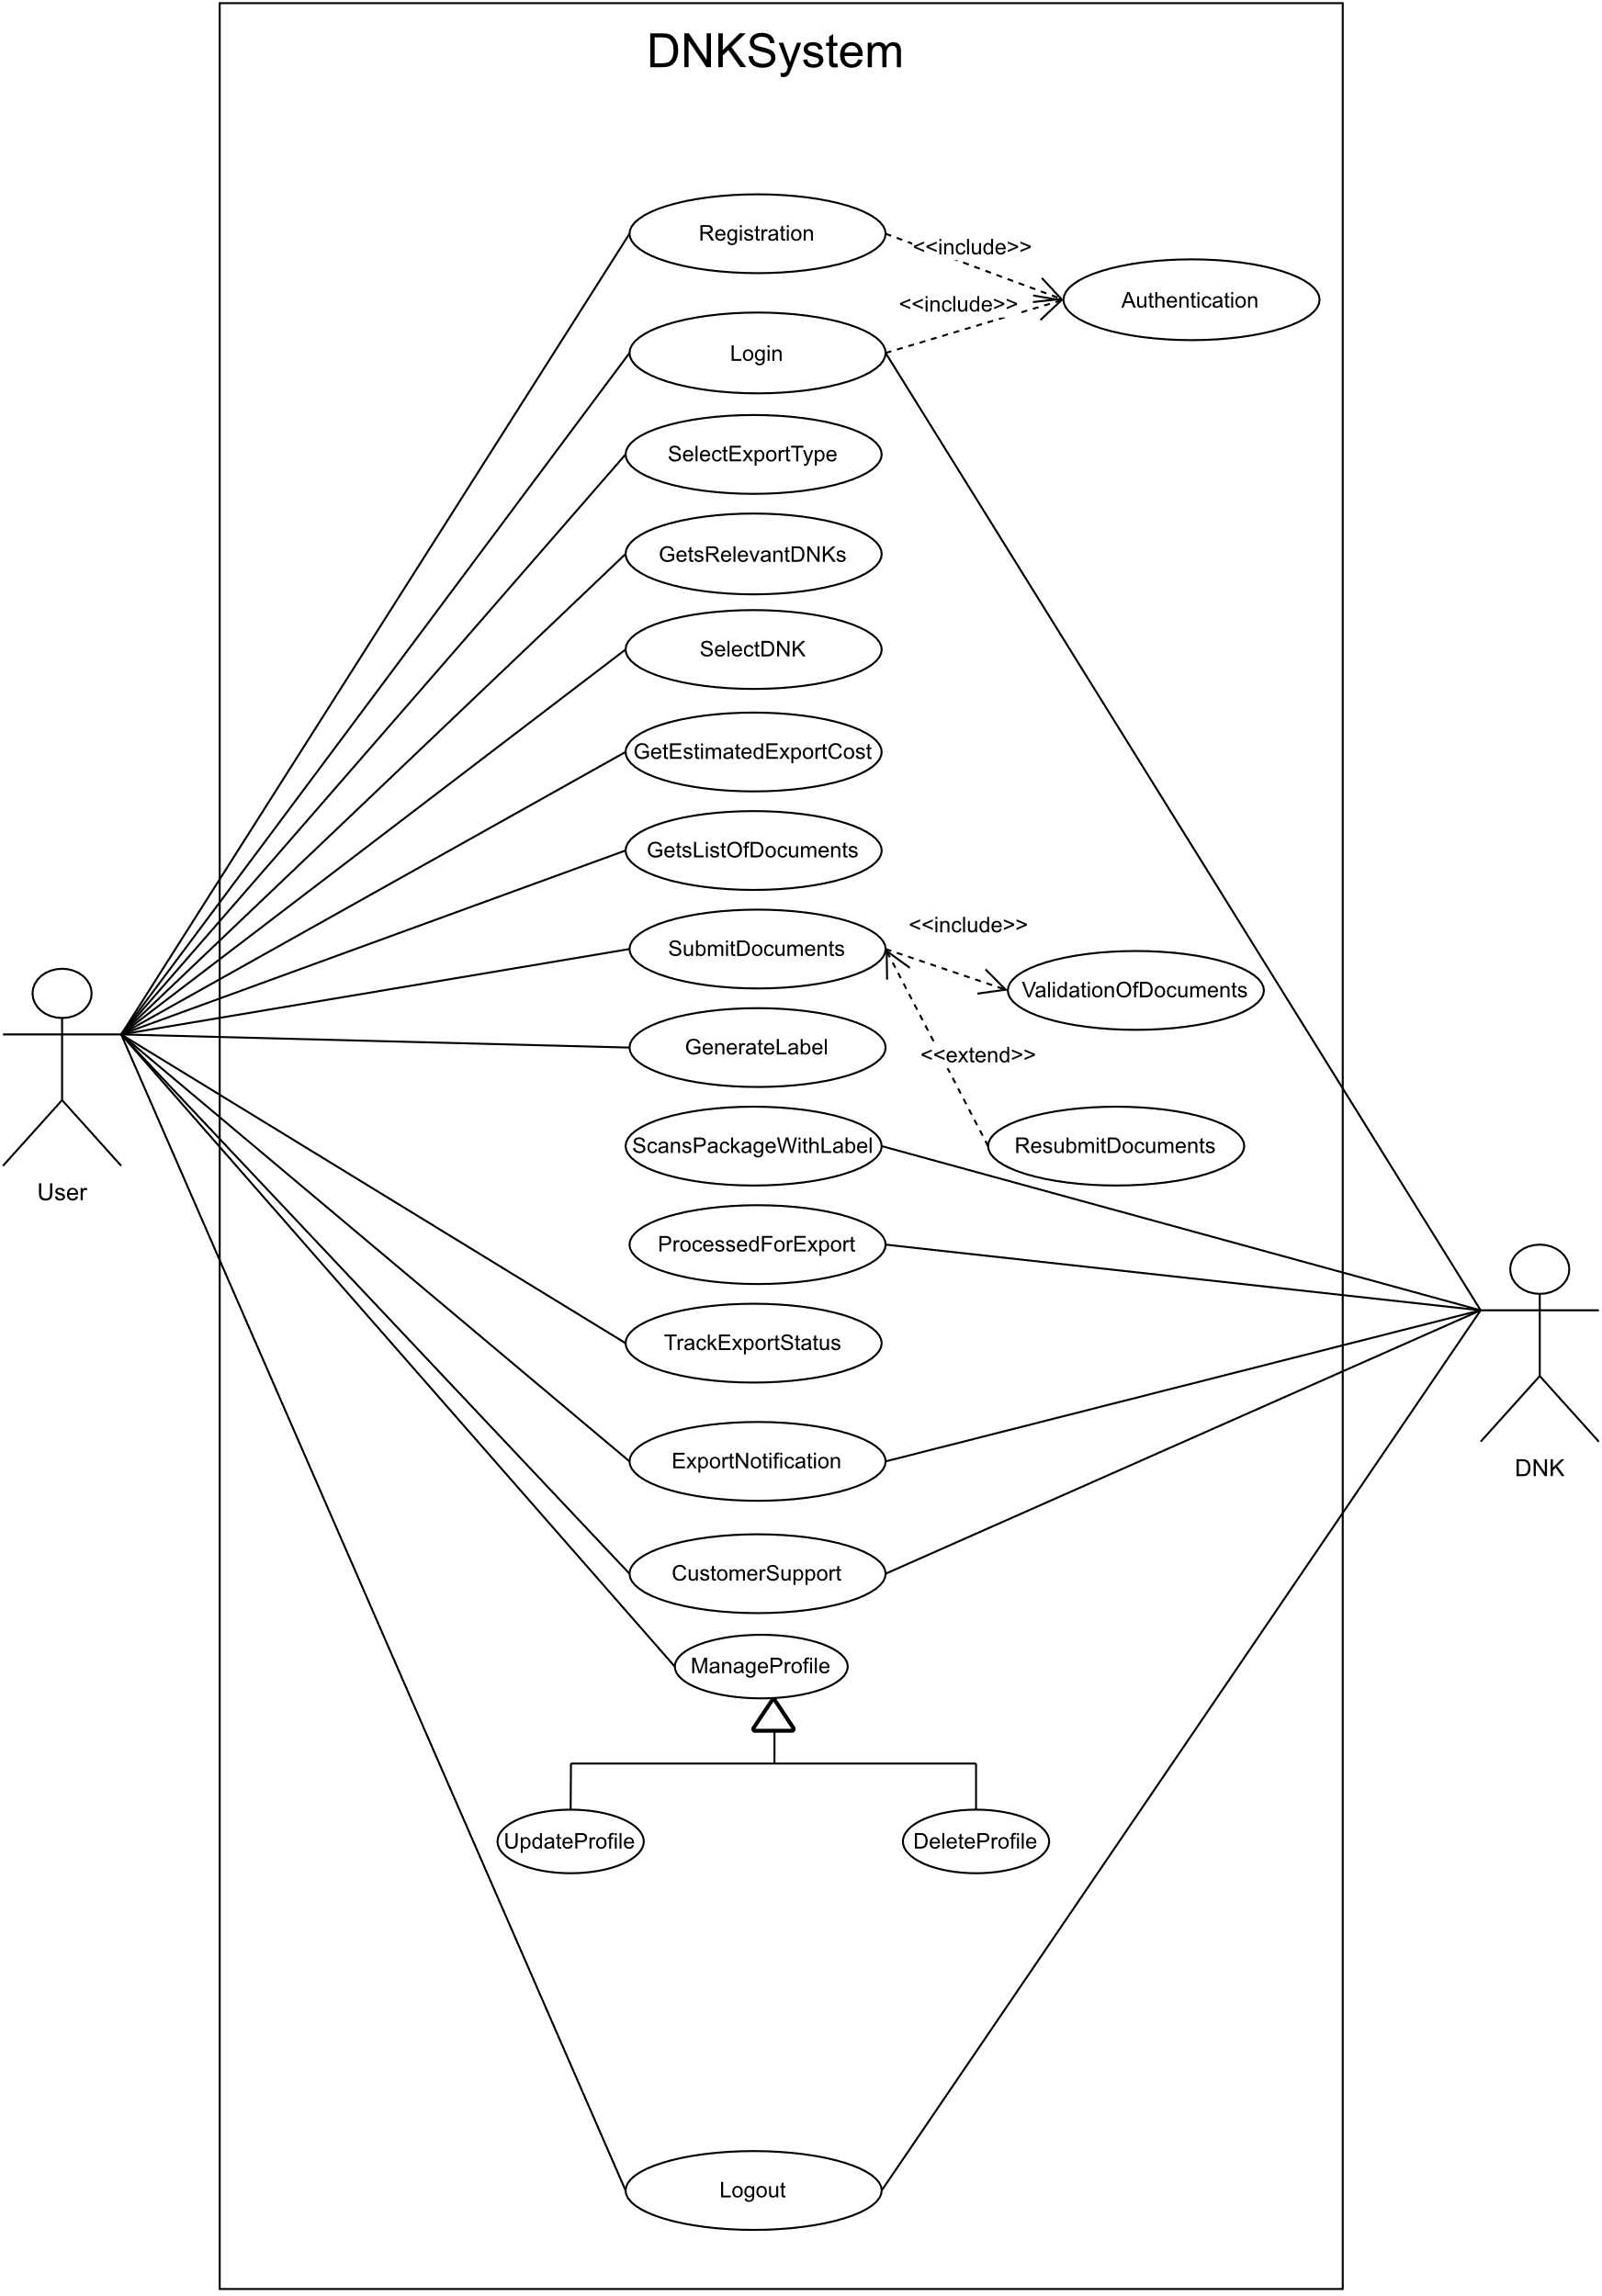


Idea/Approach Details
Use Case
SHOW STOPPER
This DNK System Simplifies Export for small traders and artisans, etc., By reducing paperwork and making it more accessible.
Package With
Digital Label
Someone At DNK Scans QR
Automated Transaction Details Generation
Dak Ghar Niryat Kendra

Slide 4
Team Member Details
Team Leader Name: UZZMA SAIYED
Msc. Stream (ECE, CSE etc): Year (I,II,III,IV): I
Team Member 1 Name: SMIT JOSHI
Msc. Stream (ECE, CSE etc): Year (I,II,III,IV): I
Team Member 2 Name: TEJASV MODI
Msc. Stream (ECE, CSE etc): Year (I,II,III,IV): I.
Team Member 3 Name: KHUSHI LODHA
Msc. Stream (ECE, CSE etc): Year (I,II,III,IV): I
Team Member 4 Name: DIGVIJAY JAKHANIYA
Msc. Stream (ECE, CSE etc): Year (I,II,III,IV): I
Team Member 5 Name: VISHVA RAVAL
Msc. Stream (ECE, CSE etc): Year (I,II,III,IV): I
Team Mentor 1 Name: PROF. RACHANA CHAUDHARI
Category : Academic Expertise: Web and Mobile Development Domain Experience (in years): 9

